Slide 1
myFUTURE NC
Setting local attainment goals
June 2021

Slide 2

agenda
Purpose & Introductions
Local Attainment Efforts
Overview of myFutureNC
Calculating the Statewide Goal for 2030
Calculating Local Attainment Goals for 2030
Discussion
Closing and Next Steps
Notes:
To get us started, I’ll quickly highlight what we plan to cover today.
First, I don’t want to assume you are aware of the work of myFutureNC, so I’ll start by sharing an overview about who we are – why we exist – what we do – and why our work might be of interest to you.
I’ll inform you about the state’s educational attainment goal and what this means for North Carolina.
Then I’ll turn it over to Jeni and Becky who will cover the County Attainment Profiles - a data tool we have developed uniquely for each county across the state. They’ll share how the data can be useful to you and your counties, especially in identifying priorities in midst of the pandemic and then coming out of it in the months and years ahead.
We’ll then open it up for you to ask any questions, and then finally, we will close with what’s next with this work and our engagement with the General Assembly.

Slide 3
Local Attainment efforts

Slide 4
CROSS-SECTOR PARTNERSHIPS
Beaufort County
Caldwell County
Cumberland County
Davie-Davidson
Guilford
Mecklenburg County
Rowan County
Union-Anson
Vance-Granville
Wilkes-Alleghany-Ashe

Slide 5
Overview of
myFUTURE Nc

Slide 6
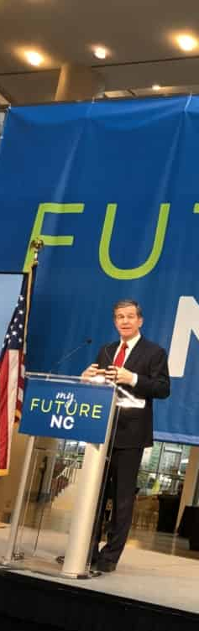
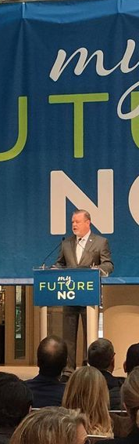
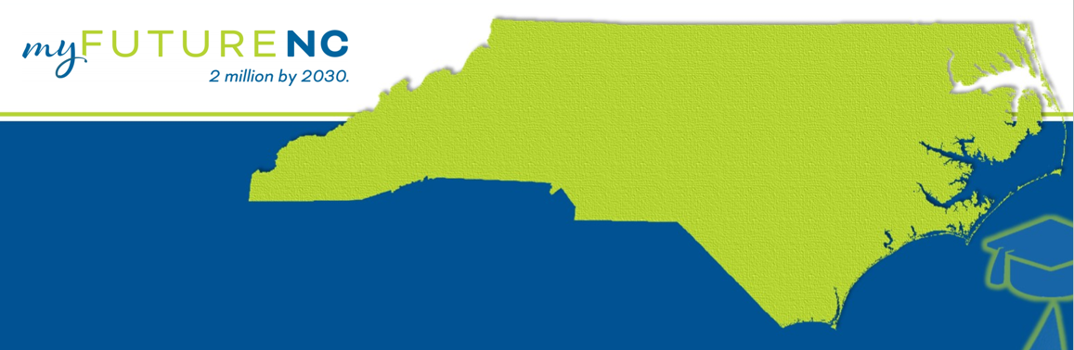
House Bill 664
To ensure that the State remains economically competitive, the State shall ensure that by the year 2030:
2 MILLION
25- to 44-year-olds will have completed a high-quality credential or postsecondary degree

Slide 7
myFUTURE NC Board of Directors | myFUTURE NC Funders
NC Governor Education Advisor | John M. Belk Endowment
NC Senate Pro Tempore Designee | Belk Foundation
NC Speaker of the House Designee | Foundation of the Carolinas: Greg Alcorn
NC Community Colleges System President | Duke Energy Foundation
UNC System President | Bill & Melinda Gates Foundation
NCICU President | Goodnight Educational Foundation
NC Public Schools Superintendent | C.D. Spangler Foundation
NC State Board of Education Chair
NC Chamber President
Business Leaders
Philanthropic Leaders
At-Large Members

Slide 8
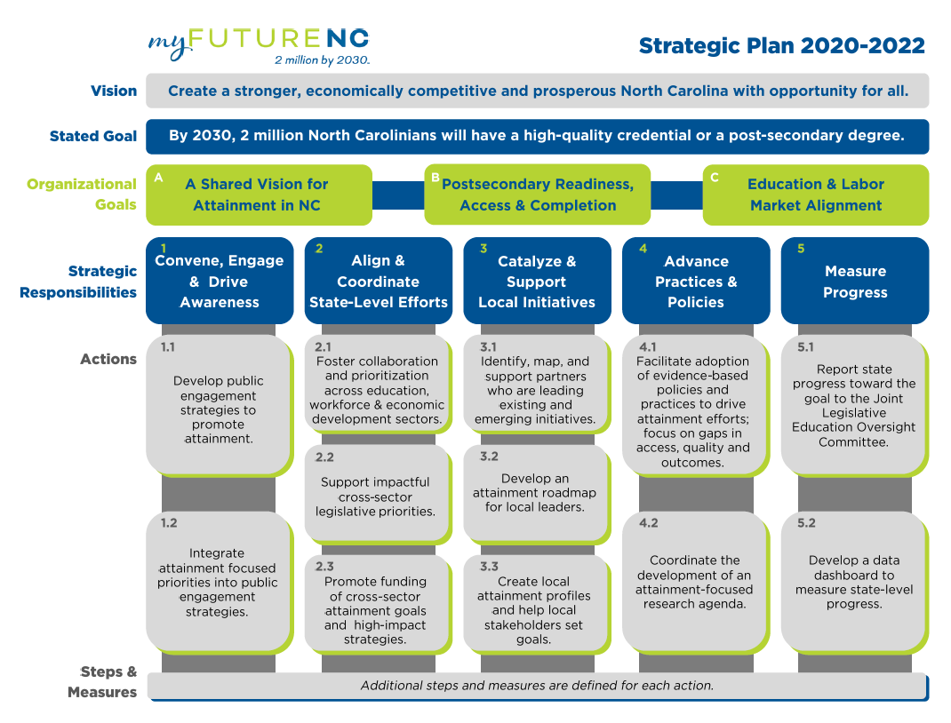
Notes:
I’ve just shared the background on why we exist and what our mission is. While we are involved in a lot of mission critical work that will ultimately help to increase educational attainment for North Carolina, for purposes of today’s webinar, we will focus on only one of our efforts which pertains to data and our ability to measure progress at the state and local levels.
Although the State collects a lot of data, getting it into a format that is usable and that captures the longitudinal view of our students, has been a significant heavy lift. Our intent in these county profiles you are about to see is not to call anyone out but rather to highlight where we are county-by-county and to elevate opportunities for growth across the state. We hope these are not only eye opening but also become a very useful tool.
With that, I’ll turn it over to Jeni.

Slide 9
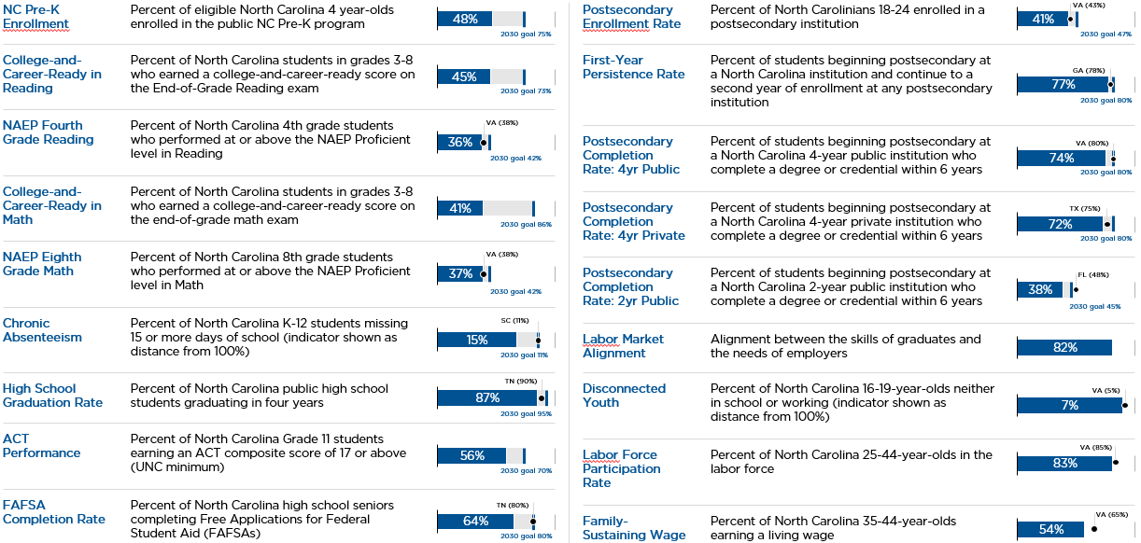
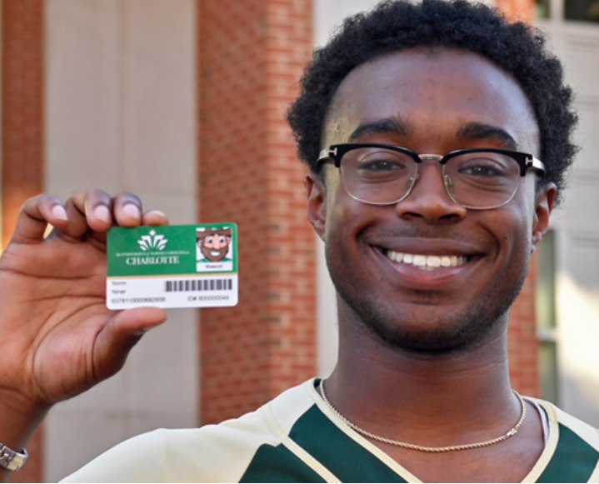
State Attainment Dashboard
Pictured: Alamance Community College

Slide 10
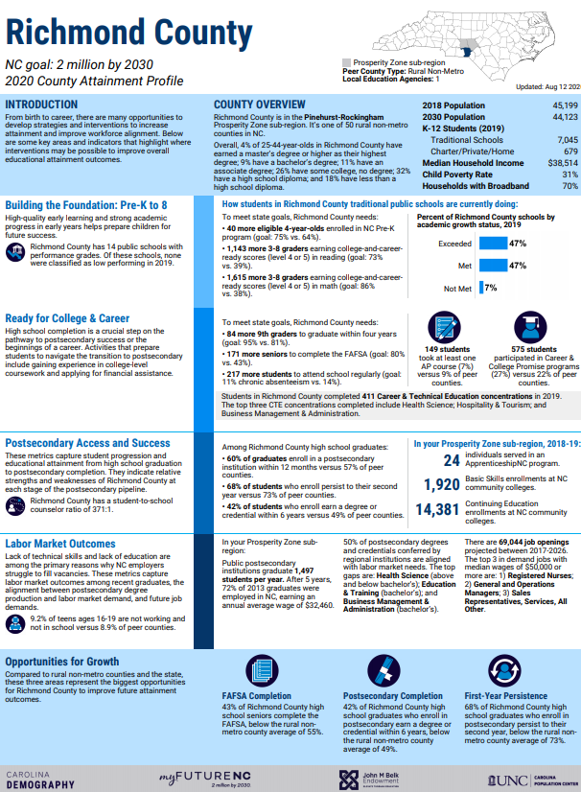
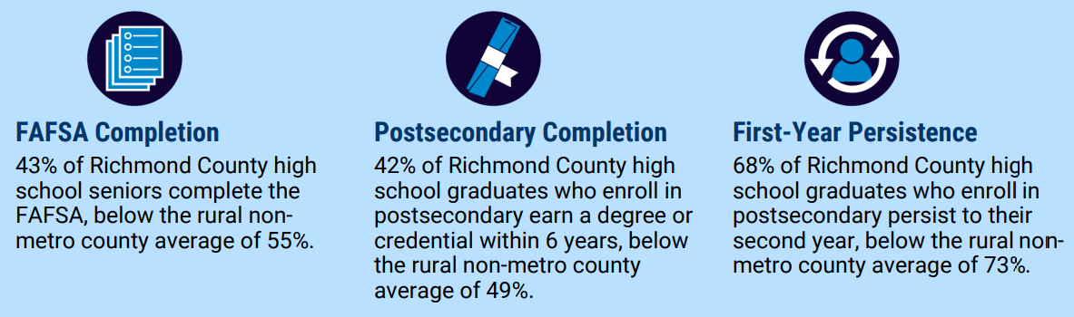
County Attainment Profiles
Data unique to each of NC’s 100 counties
Highlights county and regional performance on key indicators
Lists specific opportunities for improvement that will ultimately lead to increased attainment
Facilitates decision-making on LOCAL priorities
Uses data to identify three actionable opportunity areas to improve future attainment outcomes
Opportunities for Growth

Slide 11

Nov-Dec
Jan-Feb
Aug
Sept
7-8 local attainment goal input sessions
Hold broad stakeholder engagement sessions on local attainment goals
Publish 100 county profiles and facilitate legislative-focused webinars
Submit JLEOC Report
July
Share 100 county profiles with local leaders
NEXT STEPS

Slide 12
CALCULATING THE STATEWIDE GOAL FOR 2030

Slide 13
House Bill 664
Vision: To create a stronger, economically competitive and prosperous North Carolina with opportunity for all the State adopted a new attainment goal
2030 Goal: 2 MILLION 25- to 44-year-olds will have completed a high-quality credential or postsecondary degree

Slide 14
Projected 2030 attainment rate for NC adults 25-44, by race/ethnicity

Slide 15
Male-female attainment gap projected to stay at ~9% through 2030

Slide 16
CALCULATING LOCAL ATTAINMENT GOALS FOR 2030

Slide 17
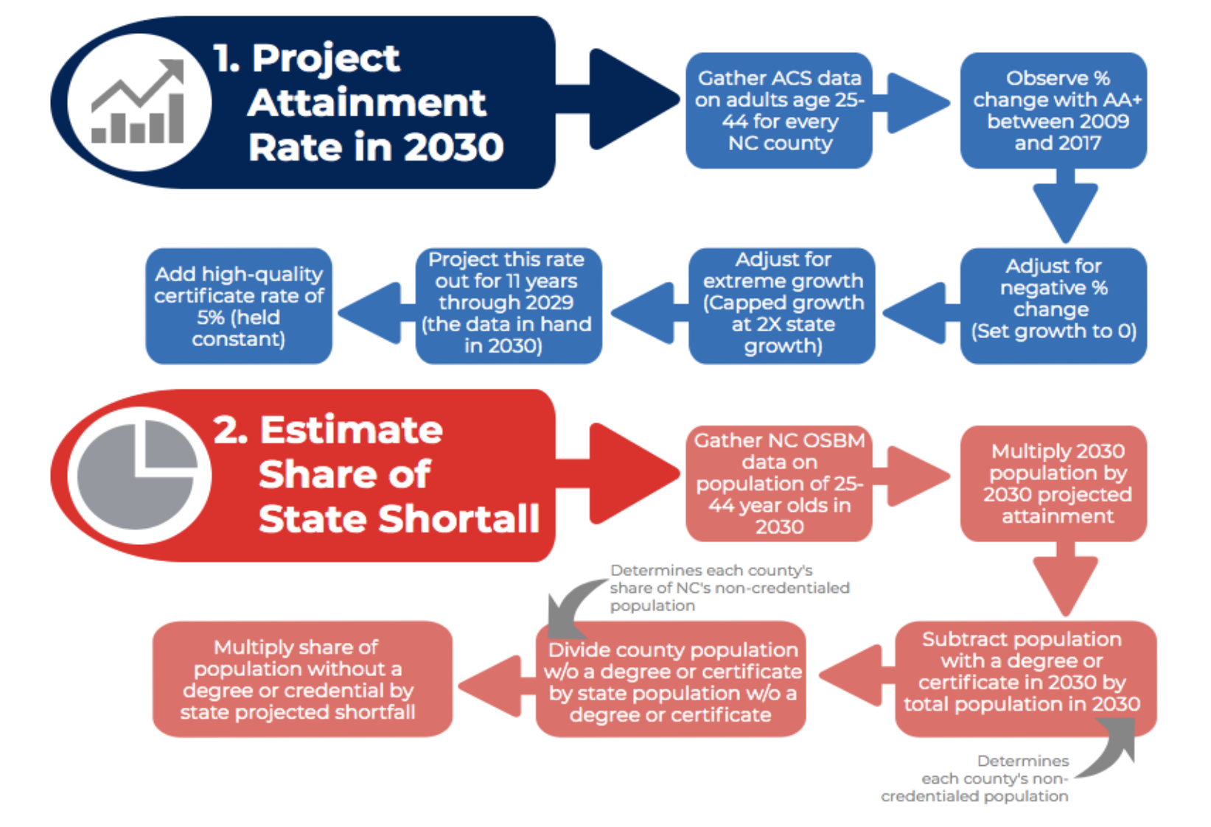
Observe % change with AA+ between 2009 and 2018
Add high-quality certificates (5%) & certifications (2.5%)
Project this rate out through 2030
(12 years)

Slide 18
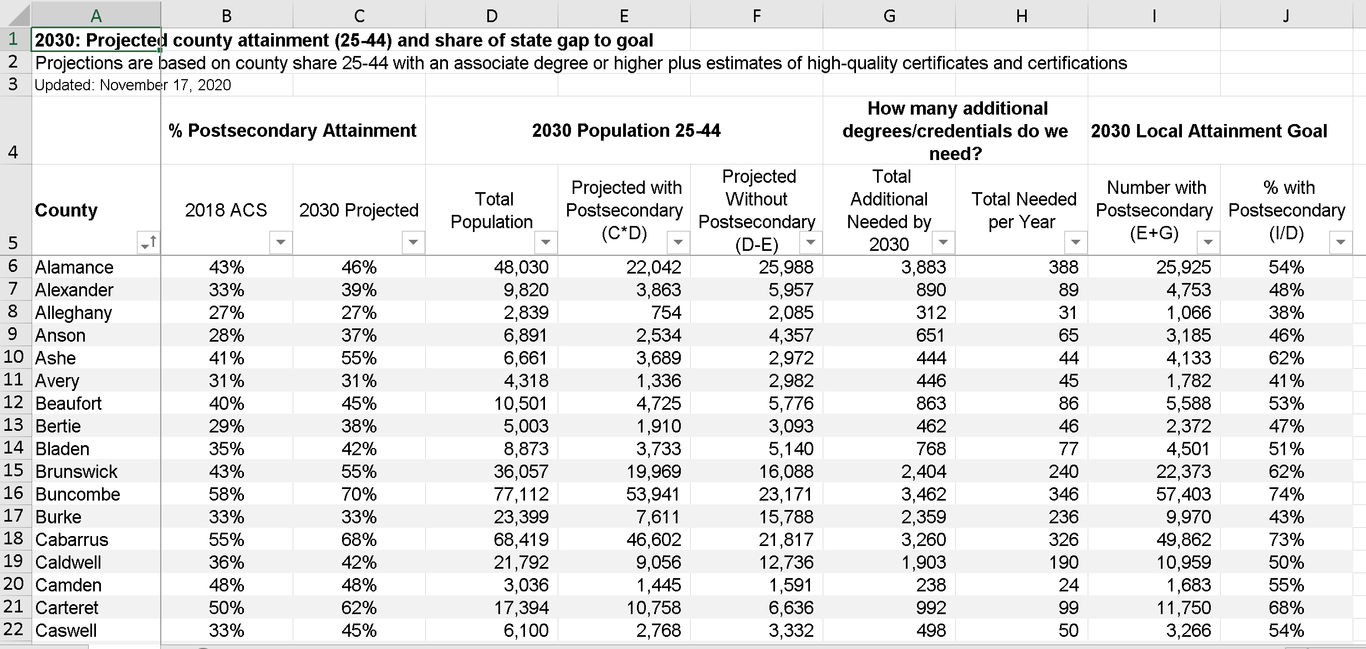

Slide 19
Discussion

Slide 20
myFutureNC Team Questions
Does the calculation for estimating local goals seem accurate and realistic?
What are your concerns about setting local attainment goals?
What is an appropriate timeline for rollout given COVID?
Should the goals be county specific or regional? If attainment goals are set regionally, how does that work in practice?
How can we help you track and measure progress?
What degrees/credentials should count?

